Slide 1
Deep Learning
Introduction to Deep Learning

Slide 2

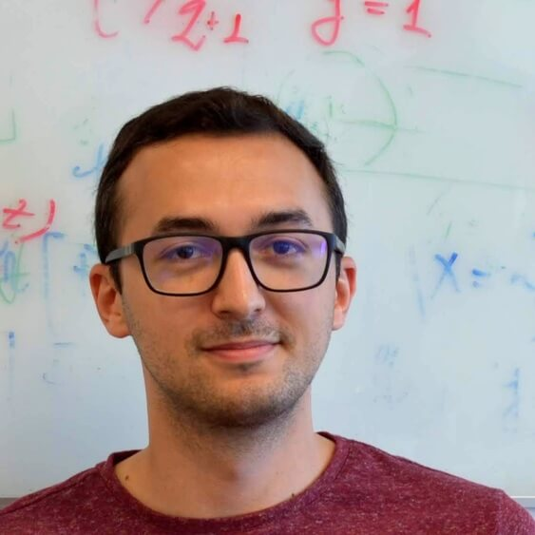
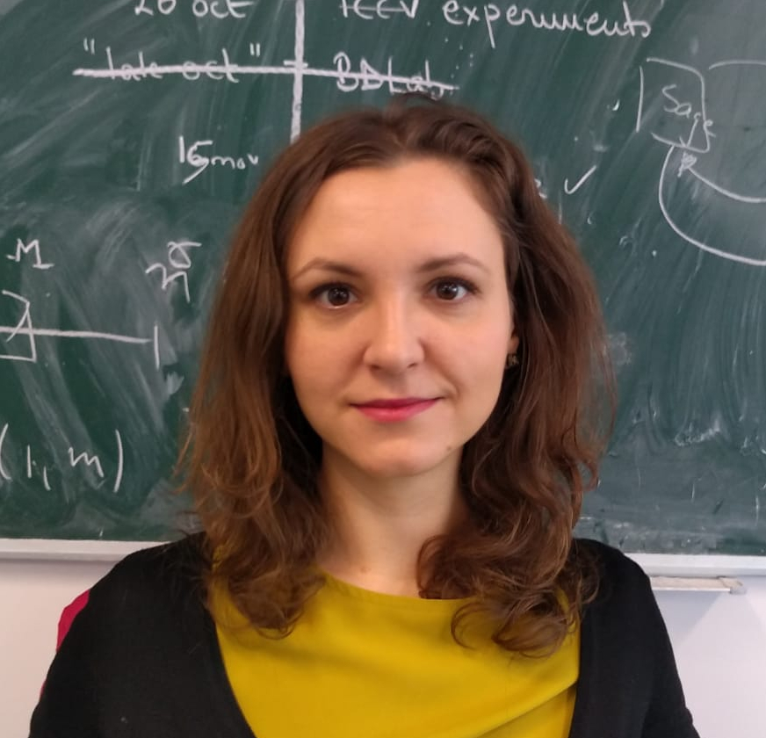
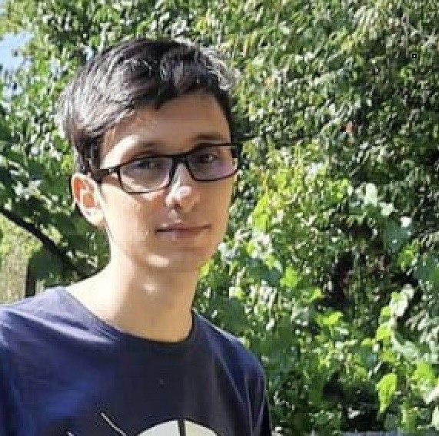
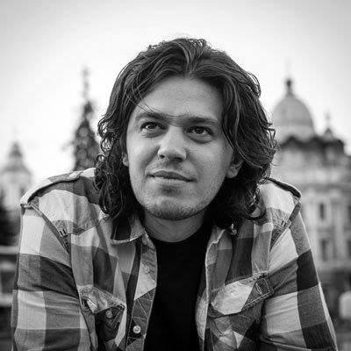




Course Team
Invited Speaker
Florin
Brad
Elena
Burceanu
Marius
Drăgoi
Florin
Gogianu
Andrei Nicolicioiu
Mila, Montreal, Canada
Andrei
Manolache
Elisabeta
Oneață
Ștefan Smeu
{fbrad, eburceanu, mdragoi, fgogianu, amanolache, eoneata, ssmeu}@bitdefender.com
andrei.nicolicioiu@gmail.com

Slide 3

Our Team
Team page: bit-ml.github.io

Slide 4
AI / ML Community
Bucharest
Bucharest Deep Learning
AI Reading Group @ Unibuc
Bucharest AI
AI Romania
Events
Romanian AI Days
Late September
EEML Summer School
15-20 July 2024 - Novi Sad, Serbia

Slide 5
Eastern European Machine Learning Summer School
Deep Learning lectures
Tutorial sessions
Paper reading sessions
Poster sessions
Top speakers from: DeepMind, Google, New York University, McGill, ETH Zurich, Cambridge, Oxford
Application
Extended abstract
Deadline: 29 March 2024
15-20 July 2024, Novi Sad, Serbia
https://www.eeml.eu/home
BONUS points for acceptance

Slide 6
AI / ML Community
Research Centers:
FMI: Marius Popescu, Bogdan Alexe, Radu Ionescu, Liviu Dinu et al.
UPB: Traian Rebedea, Marius Leordeanu et al.
IMAR: Marius Leordeanu et al.
UT (Cluj): Lucian Bușoniu et al.
Bitdefender: bit-ml.github.io team
Siemens (Brașov): Lucian Itu et al.
Industry:
Bitdefender: ML
Arnia: Outsourcing CV, NLP
Sparktech: Outsourcing CV, NLP
Xperi: CV
Siemens (Brasov): Medical CV, ML
BOSCH (Cluj): Autonomous driving
Continental (Timișoara): Autonomous driving
Adobe: NLP, CV

Slide 7
Administrative

Slide 8
Program
Lectures
Each Wednesday: 18:00 - 20:00 (Room 1)
3 speed tests
5 minutes
1-2 short questions
Labs
Each Wednesday: 16:00 - 18:00 (Room 303)
Course Materials
https://drive.google.com/drive/folders/1smd1apqWeA6j_ks8CpOQA5msIeQNlBcp

Slide 9
Assignments and Projects
2 Assignments (PyTorch)
Related to the lab content
Submission deadline: 2 or 3 weeks after publishing
penalties for delays
Both of them will be presented in Week 9
1 Project (PyTorch)
Teams of 2 members
Subjects will be proposed in Week 4
Each student should choose a subject until Week 6
Will be presented in Week 10 - Poster Session

Slide 10
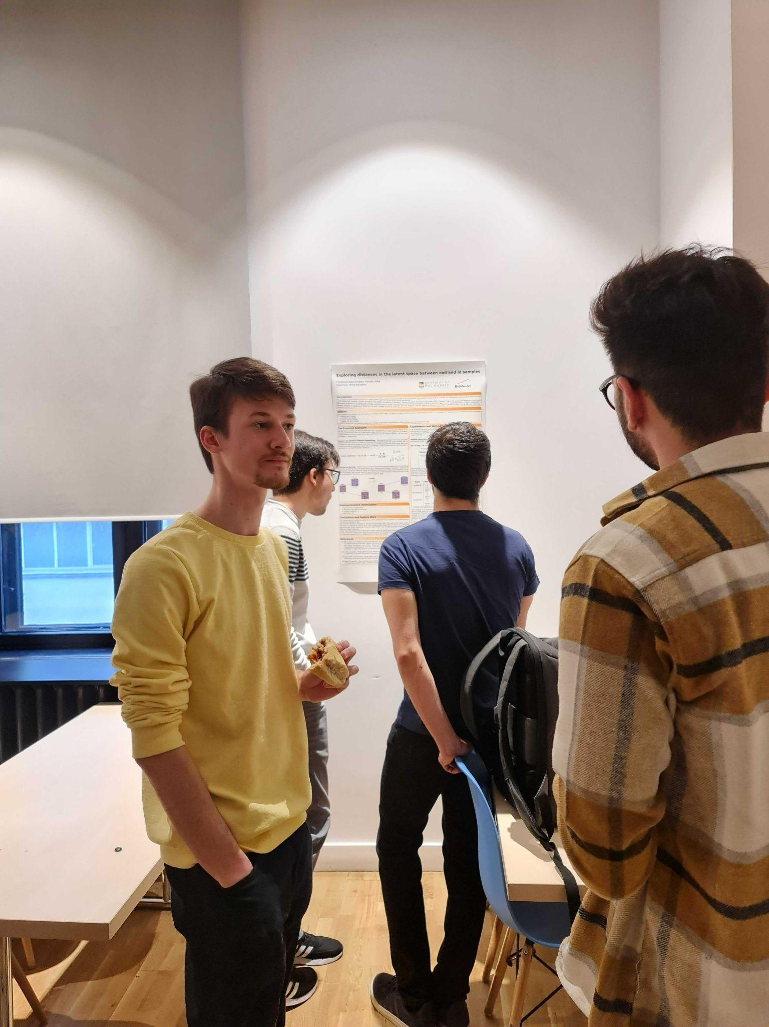
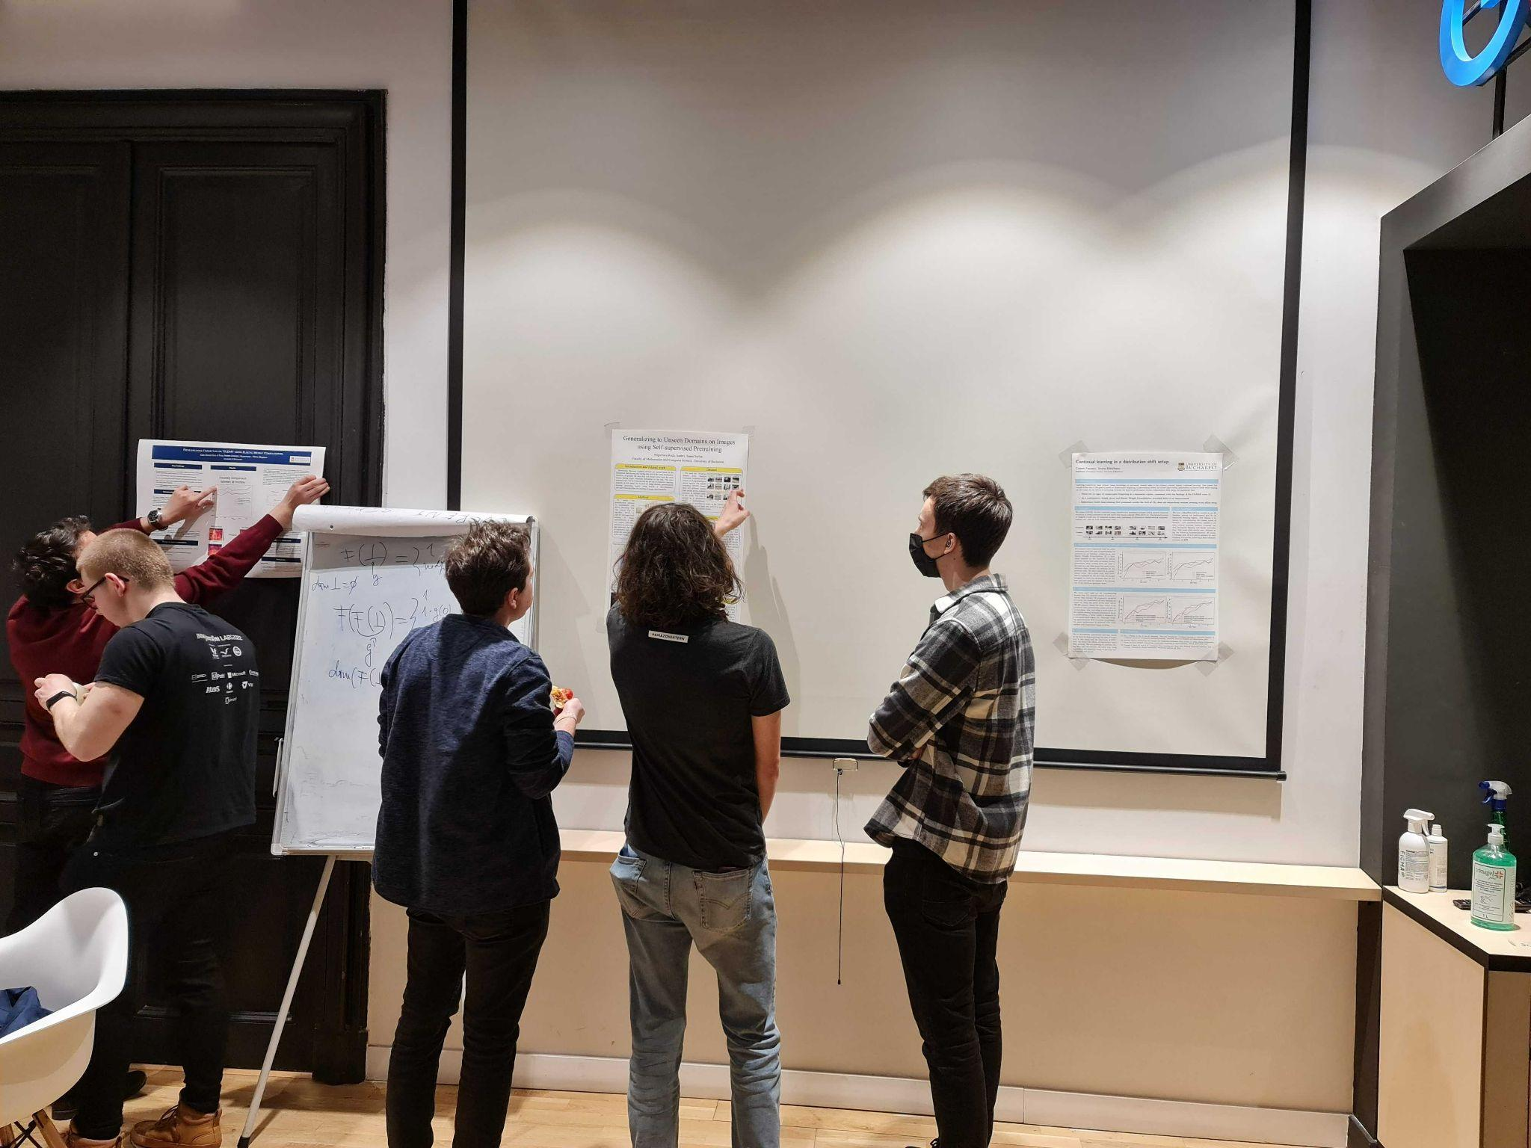
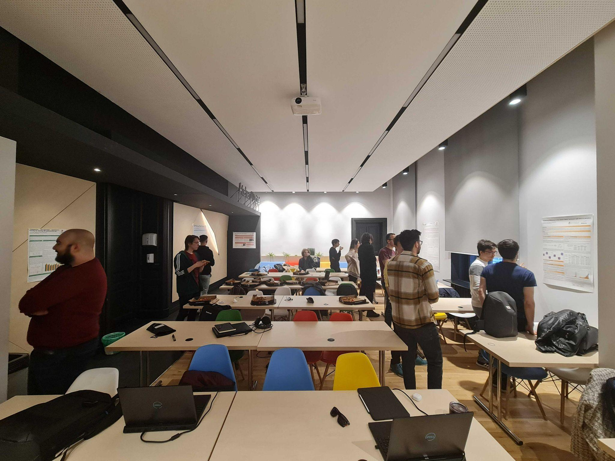
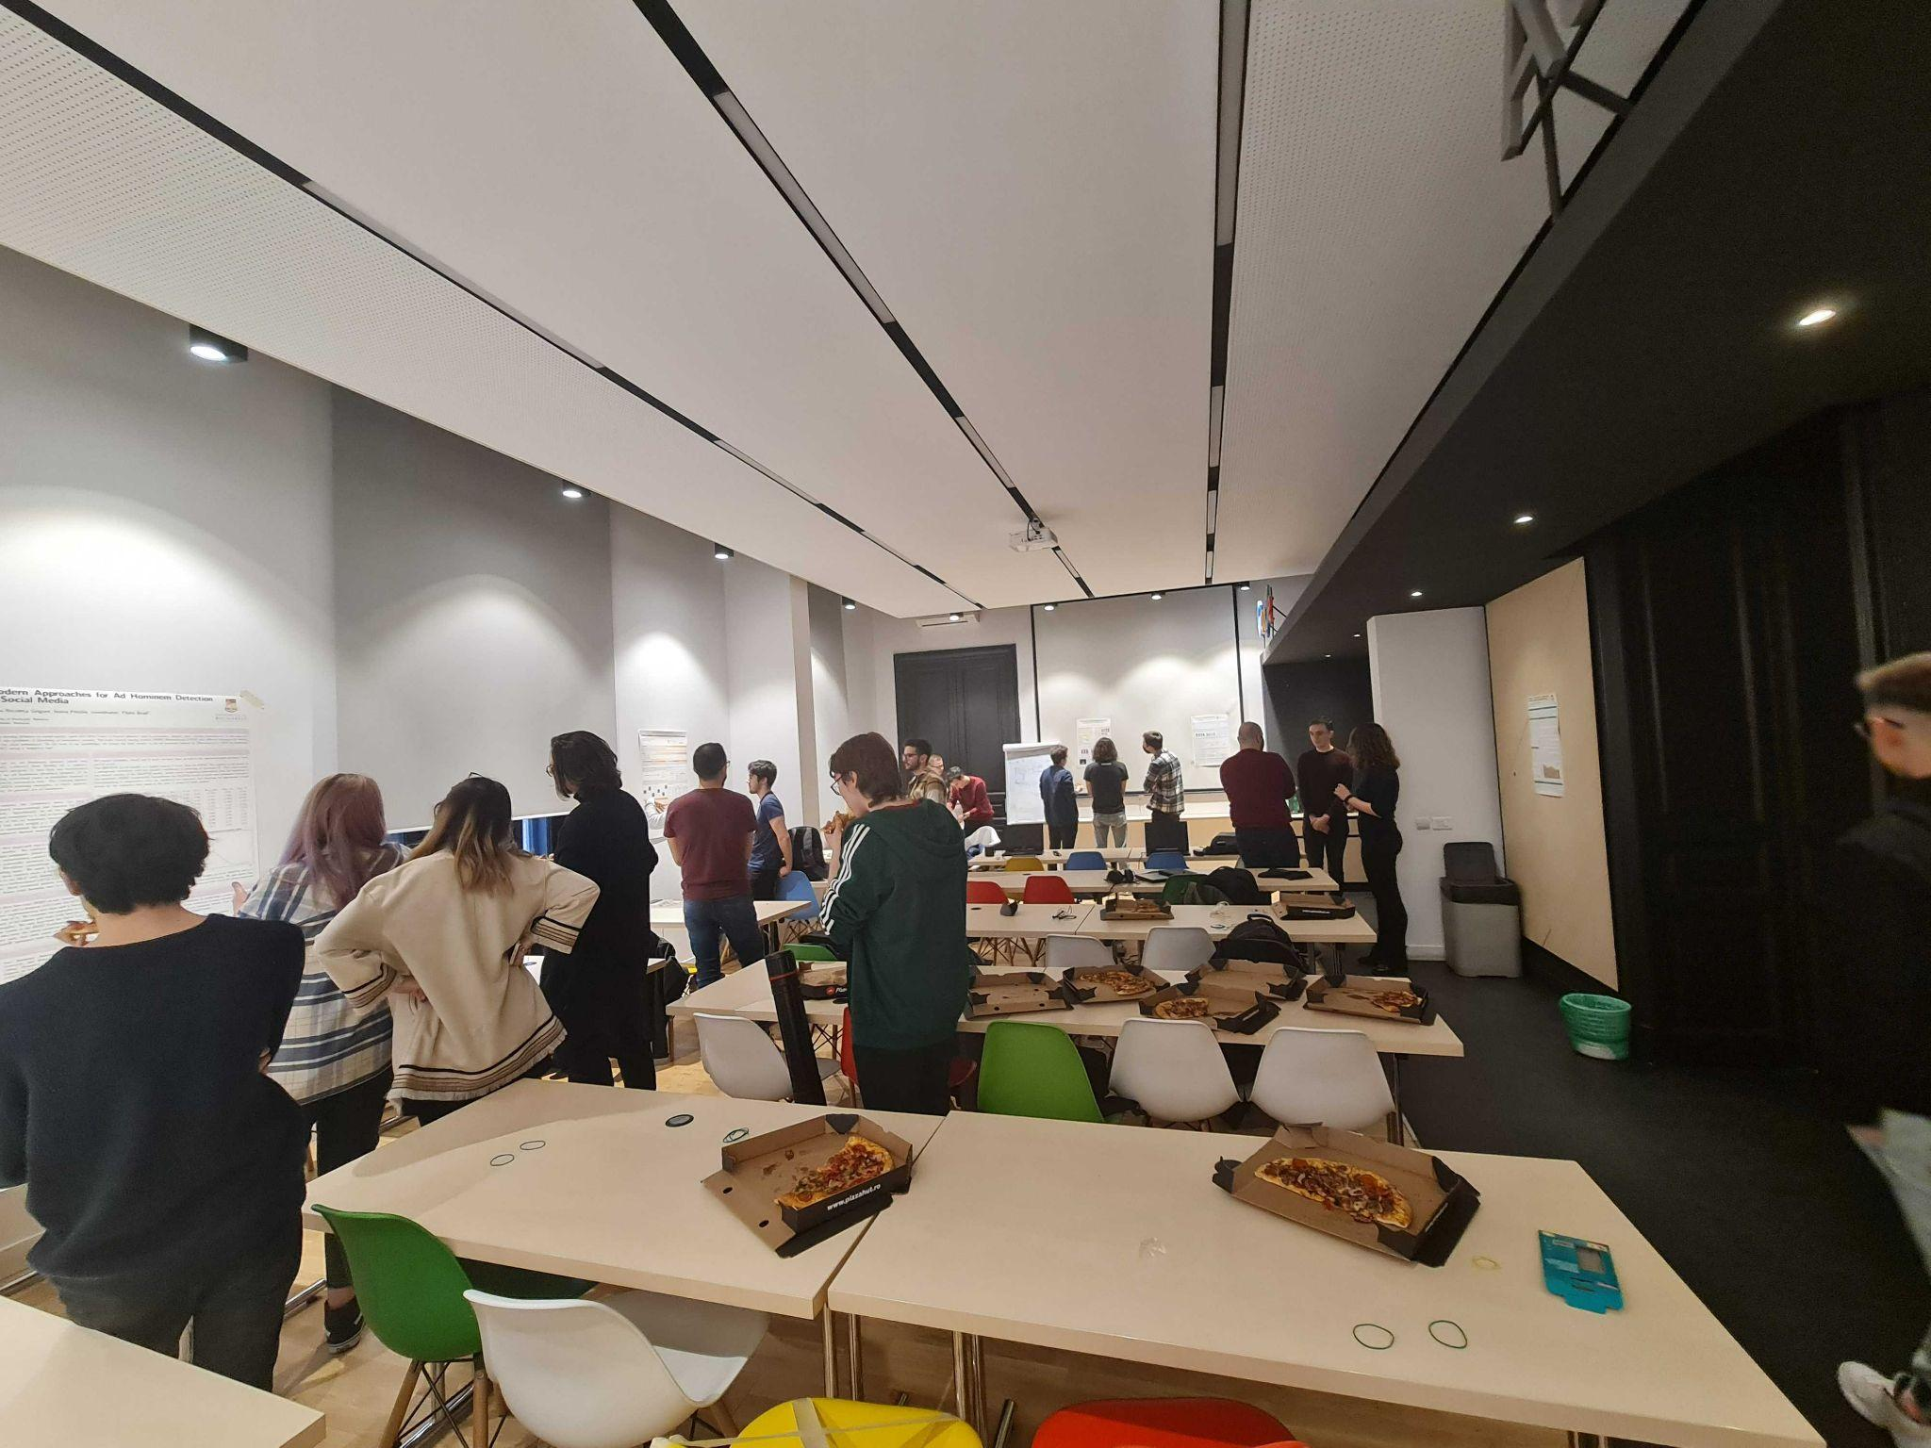
Poster Session

Slide 11
Course Structure
Week | Lecture | Speed Test | Laboratory | Event | Deadline
1 | Introduction to Deep Learning |  | PyTorch and Tensors
2 | Neural Networks |  | Neural Networks
3 | Optimization |  | Training and Optimization | Assignment 1 out
4 | Debugging Neural Networks | Test 1 | Debugging | Project proposals
5 | Convolutional Neural Networks |  | ConvNets (1) | Assignment 2 out | Assignment 1 EEML- March 29
6 | Computer Vision Applications |  | ConvNets (2) |  | Project selection Deadline
7 | Sequential Models | Test 2 | Sequential Models
8 | Natural Language Processing Applications |  | NLP Applications |  | Assignment 2
9 | Unsupervised Learning | Test 3 | Assignments Evaluation
10 | Project Evaluation (Poster Session) |  | Project Evaluation |  | Project

Slide 12
Grading
 |  | Requirements
Assignment 1 | 2 points | 50% (2.5 points)
Assignment 2 | 2 points
3 x Speed Tests | 1 point
[BONUS] Good answers / questions during lectures and labs | max 2 points
Project | 5 points | 50% (2.5 points)
[BONUS] Good interventions / questions during the poster session | max 1 point

Slide 13
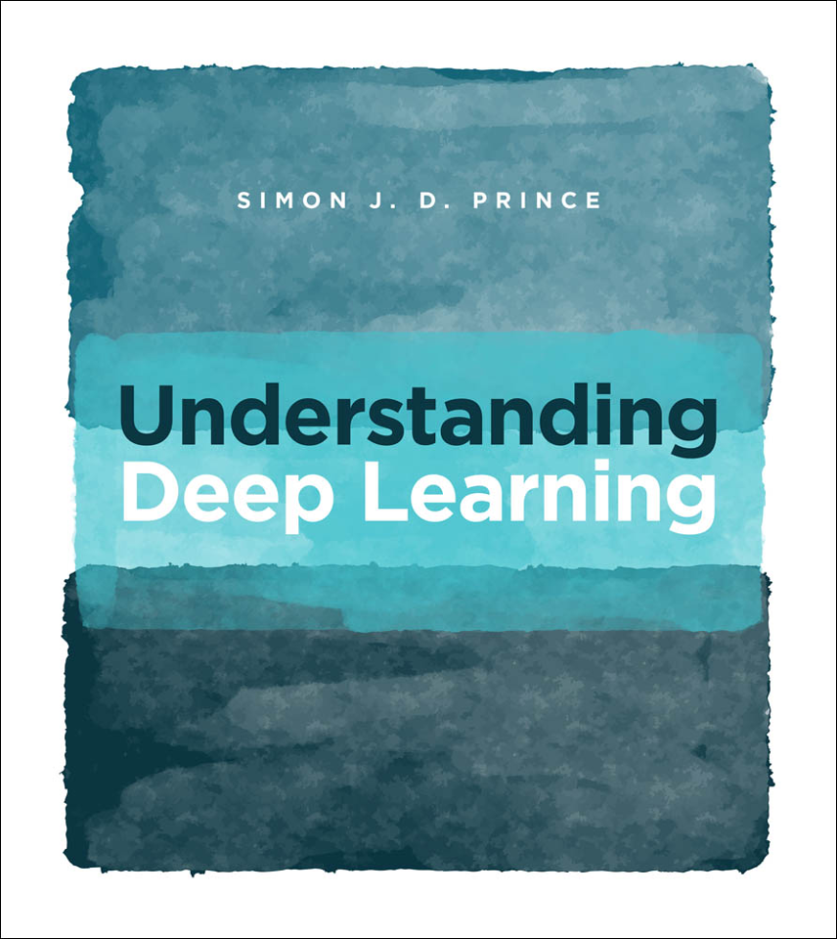
Understanding Deep Learning Book
A lot of the course and slides is based on “Understanding Deep Learning” by Simon J.D. Prince
The book is free: http://udlbook.com/
If you want to delve deeper into some concepts, we highly recommend you to read it!
Special thanks to Emanuela Haller for some of the slides for this lecture

Slide 14
Deep Learning Overview

Slide 15
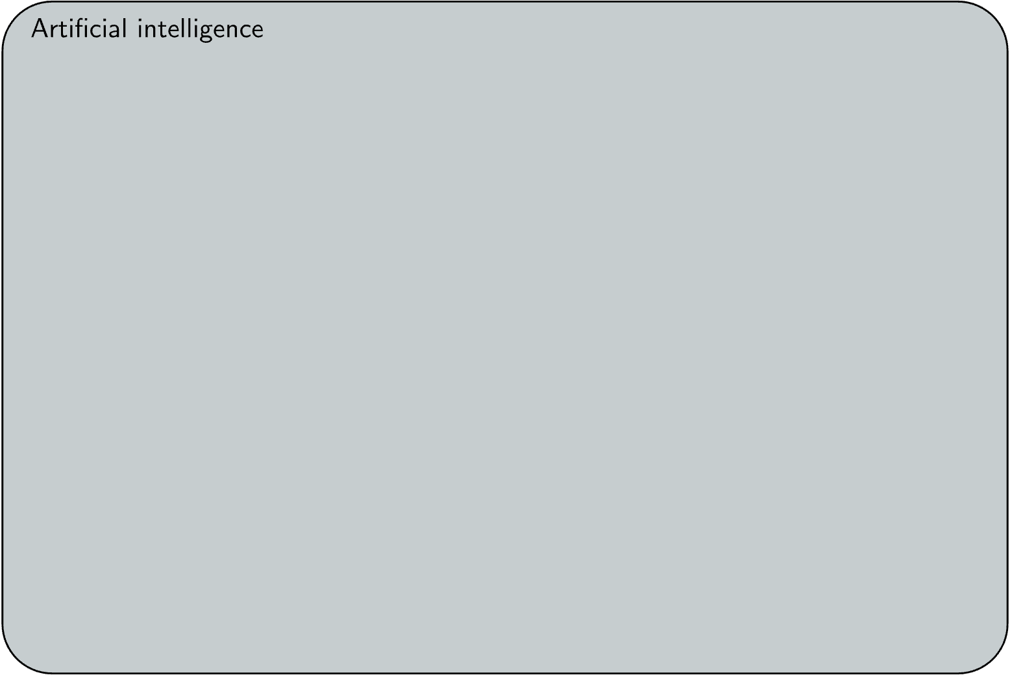
Artificial Intelligence

Slide 16
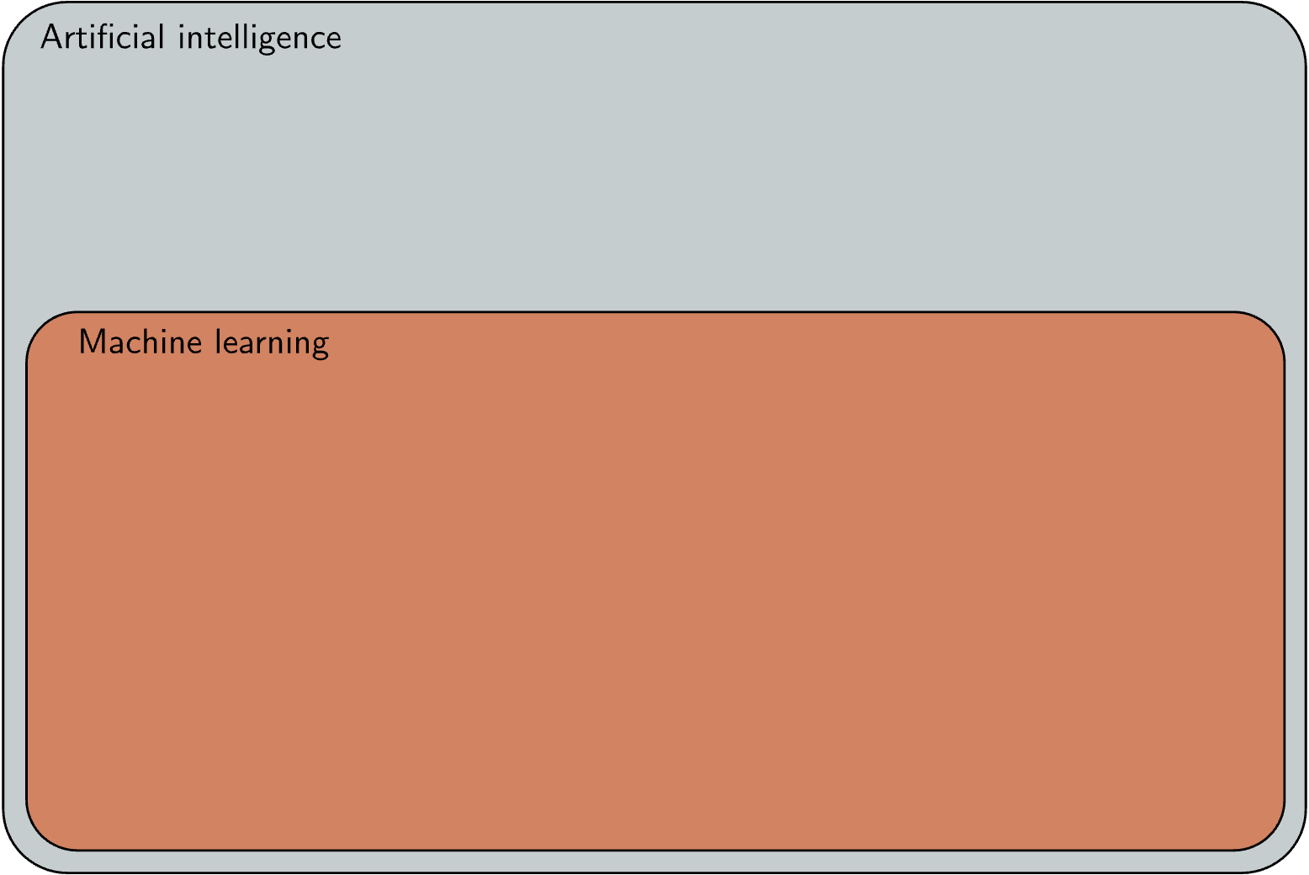
Artificial Intelligence

Slide 17
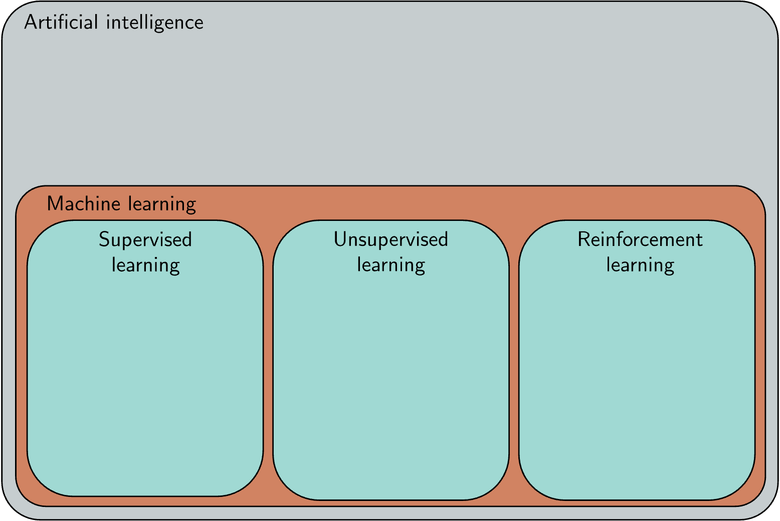
Artificial Intelligence

Slide 18
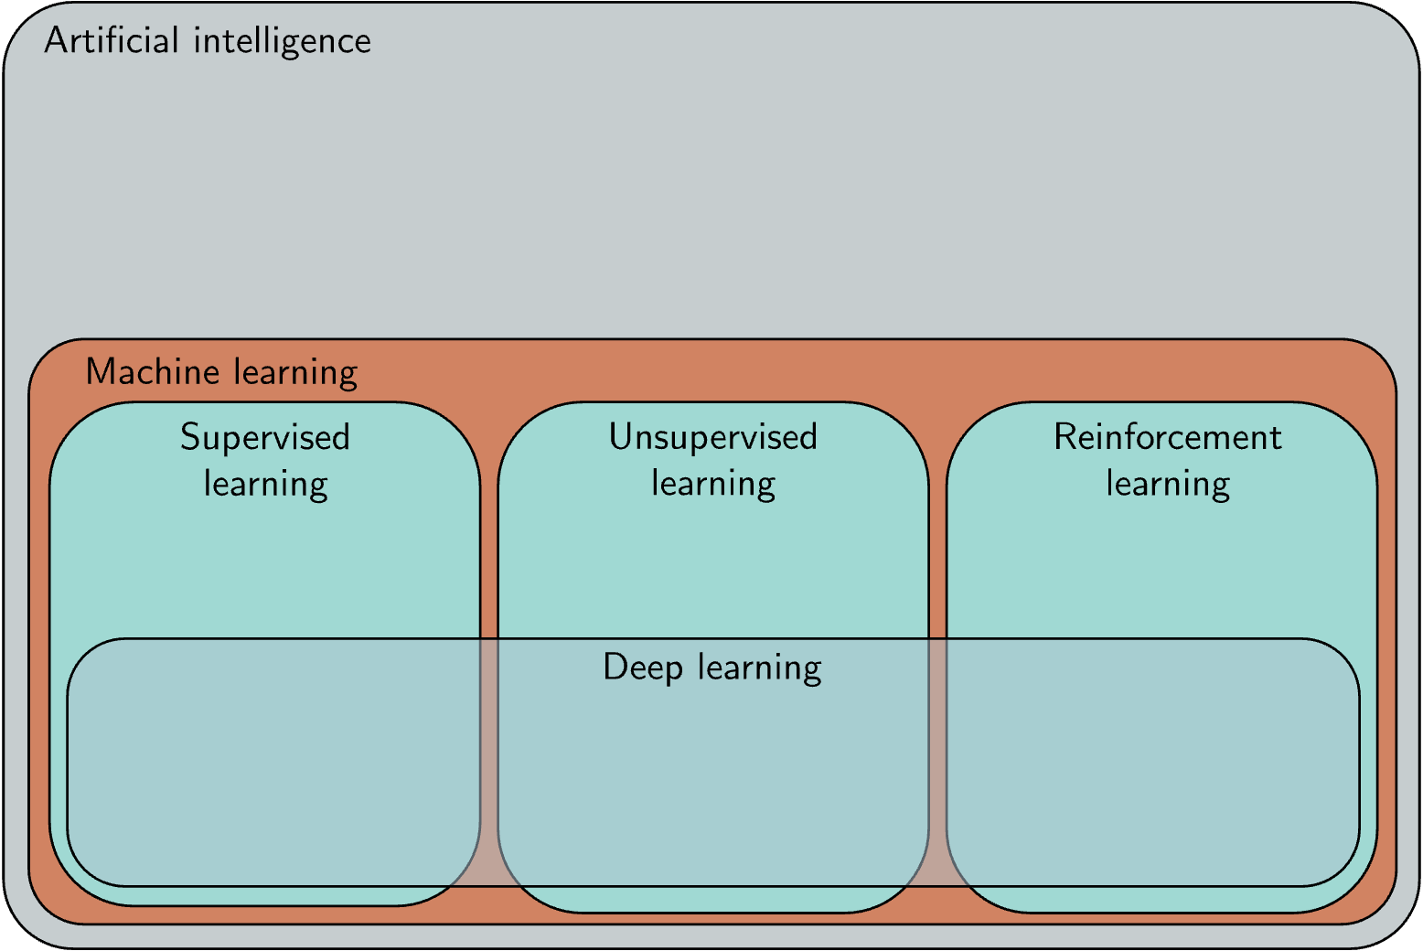
Artificial Intelligence

Slide 19

Artificial Intelligence

Slide 20
Supervised Learning
Main idea:
Given an input “x” we want to obtain a label “y”
We want to “learn” a mapping from x to y

Slide 21
Supervised Learning
Main idea:
Given an input “x” we want to obtain a label “y”
We want to “learn” a mapping from x to y
Examples:
Does this picture contain a cat or a dog? f(picture) = dog/cat
Is the sentiment in this text positive or negative? f(text) = positive/negative
What should be the price of this house? f(house) = [0, 1.000.000] $

Slide 22
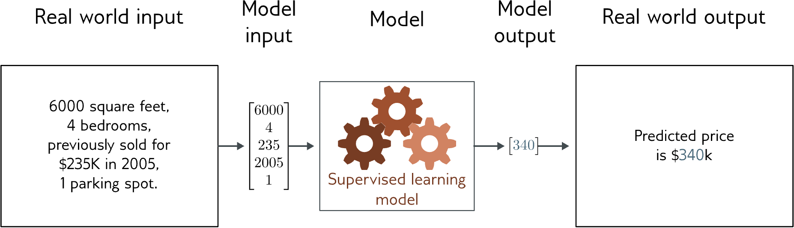
Regression
Given some characteristics, predict one real number
Linear, fully-connected neural network

Slide 23
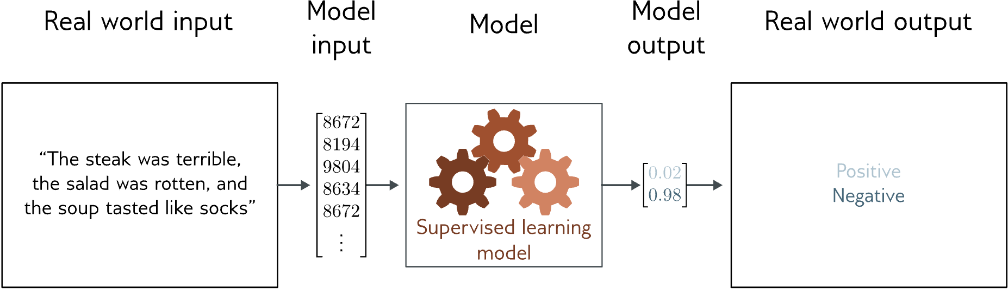
Text classification
Given some text, output the sentiment
Transformers, Recurrent neural networks

Slide 24
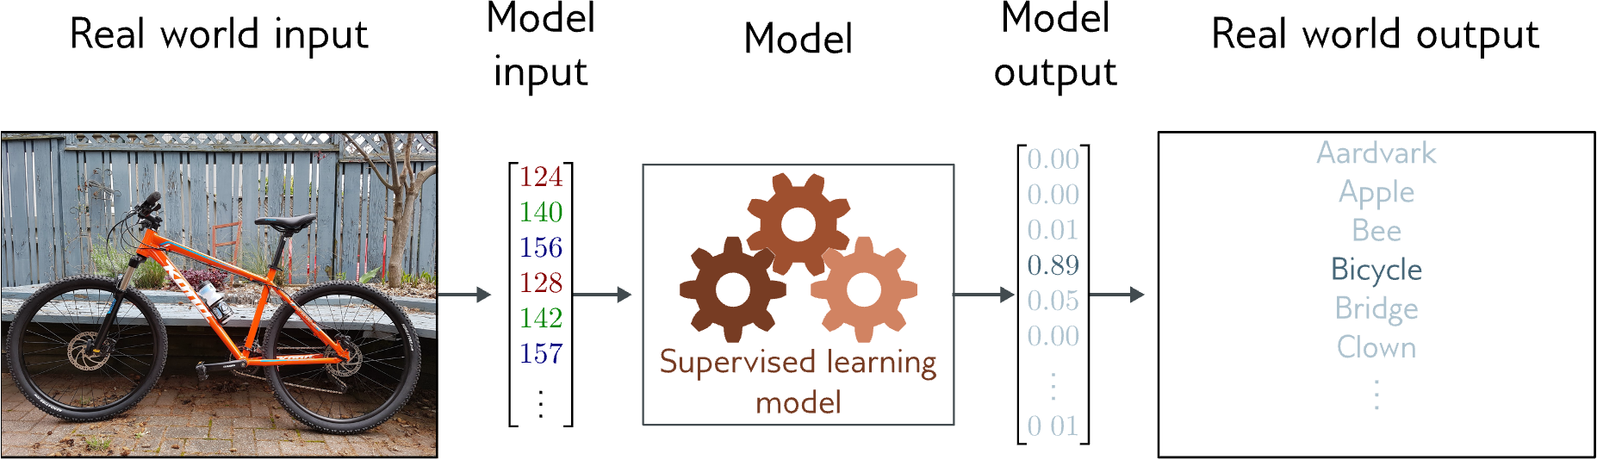
Image classification
Given some image, output the sentiment
Visual Transformers, Convolutional neural networks

Slide 25
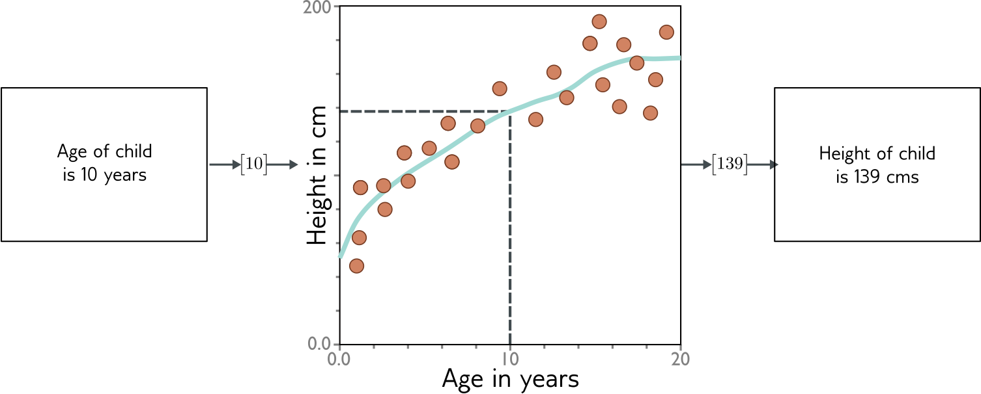
What is the “model”?
The “model” is an equation relating the input (age) with the output (height)
We want to search for the equation that best fits our data (learning)

Slide 26
What is the “model”?
Deep neural networks are just a family of very flexible equations
Finding a “good” neural network for the given data = “Deep Learning”

Slide 27
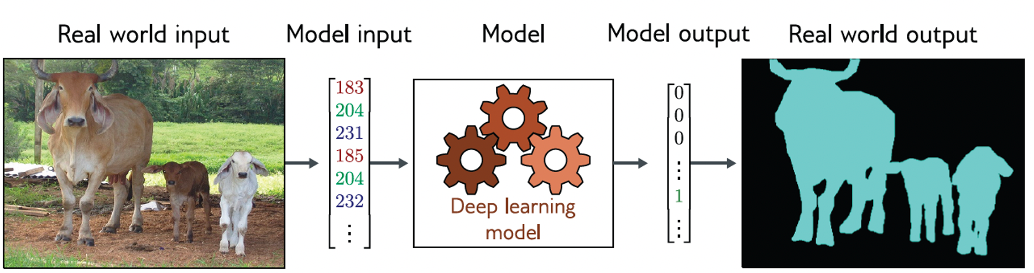
Image segmentation
Given some image, output a segmentation mask
Encoder-Decoder networks

Slide 28
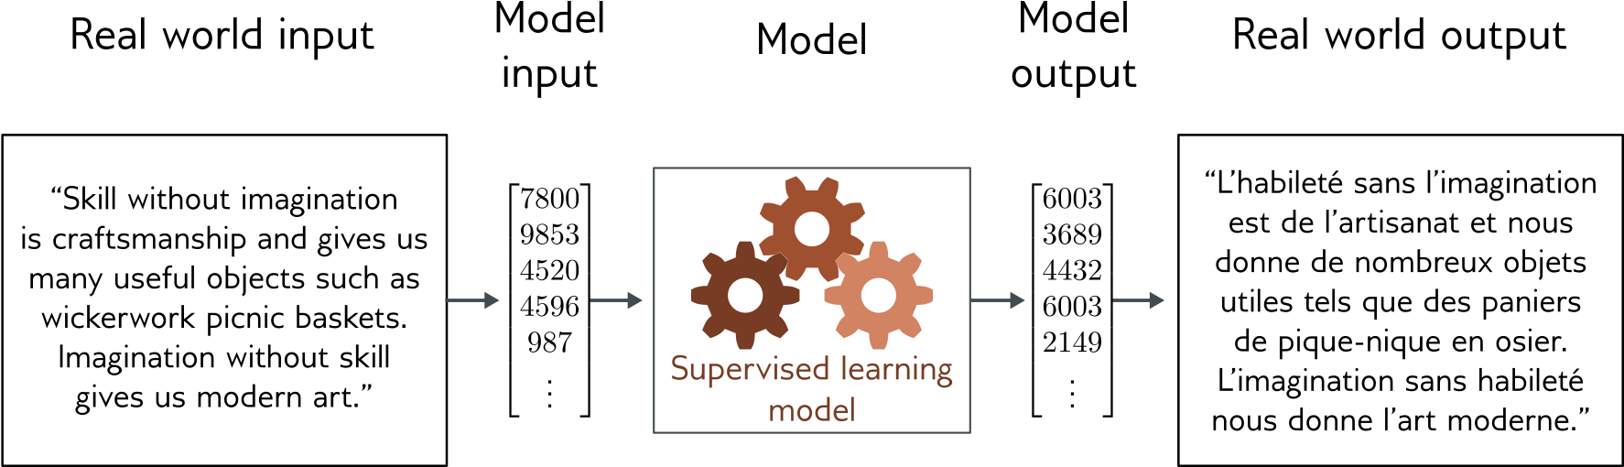
Translation
Given some text in English, output the same text in French
Encoder-Decoder networks

Slide 29
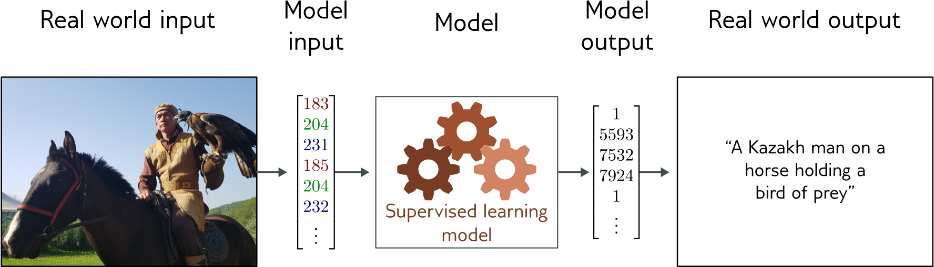
Captioning
Given some image, output a description

Slide 30
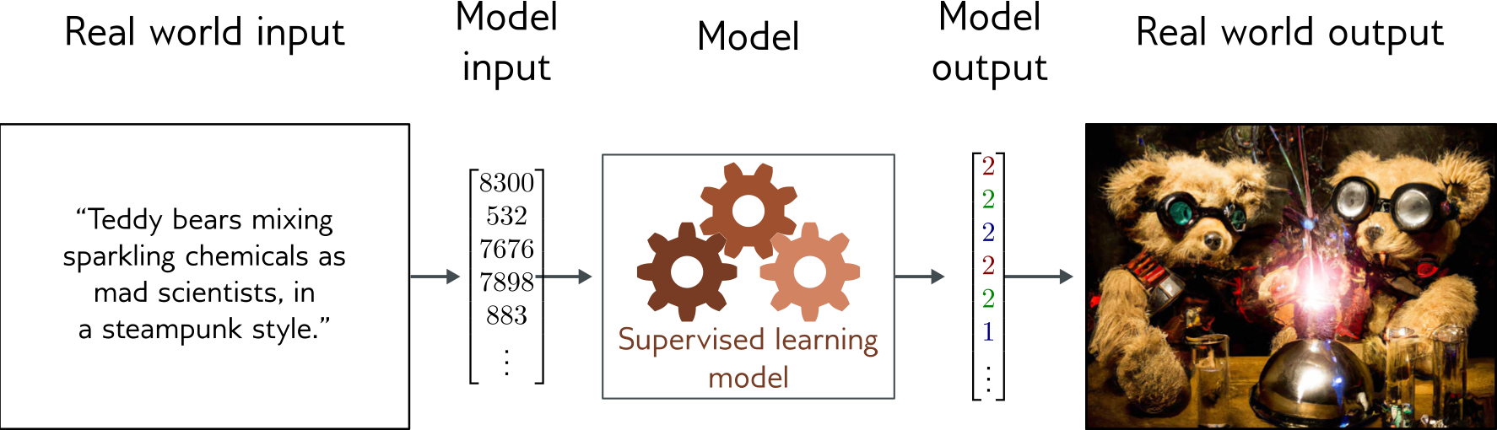
Image generation from text
Given some description, output an image

Slide 31


Sounds good! Why do we need anything else?

Slide 32
Sounds good! Why do we need anything else?
Most of the data found in the wild is not labeled
Labeling data is very expensive

Slide 33

Sounds good! Why do we need anything else?

Slide 34

Unsupervised Learning

Slide 35
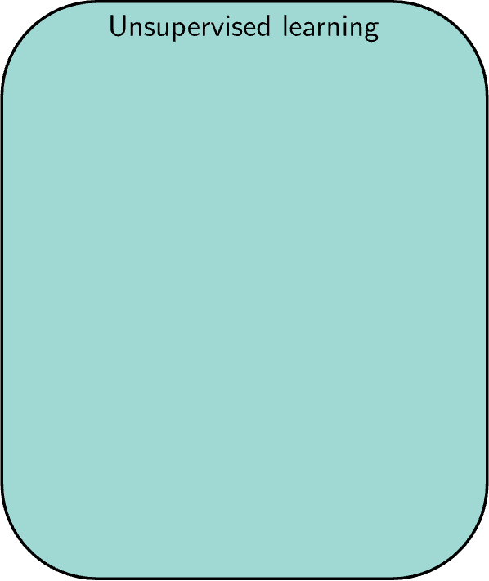
Unsupervised Learning
Learning something about the dataset without labels
Clustering
Generative modelling
Predicting missing data
Outlier detection

Slide 36
Unsupervised Learning
Learning something about the dataset without labels
Clustering
Generative modelling
Predicting missing data
Outlier detection
This is a very hot topic right now

Slide 37
Unsupervised Learning
Learning something about the dataset without labels
Clustering
Generative modelling
Predicting missing data
Outlier detection
This is a very hot topic right now
Self-supervised learning is very popular
Language Modelling (GPT, Gemini etc.)
Image generation (Diffusion etc.)
Image colorization
etc

Slide 38
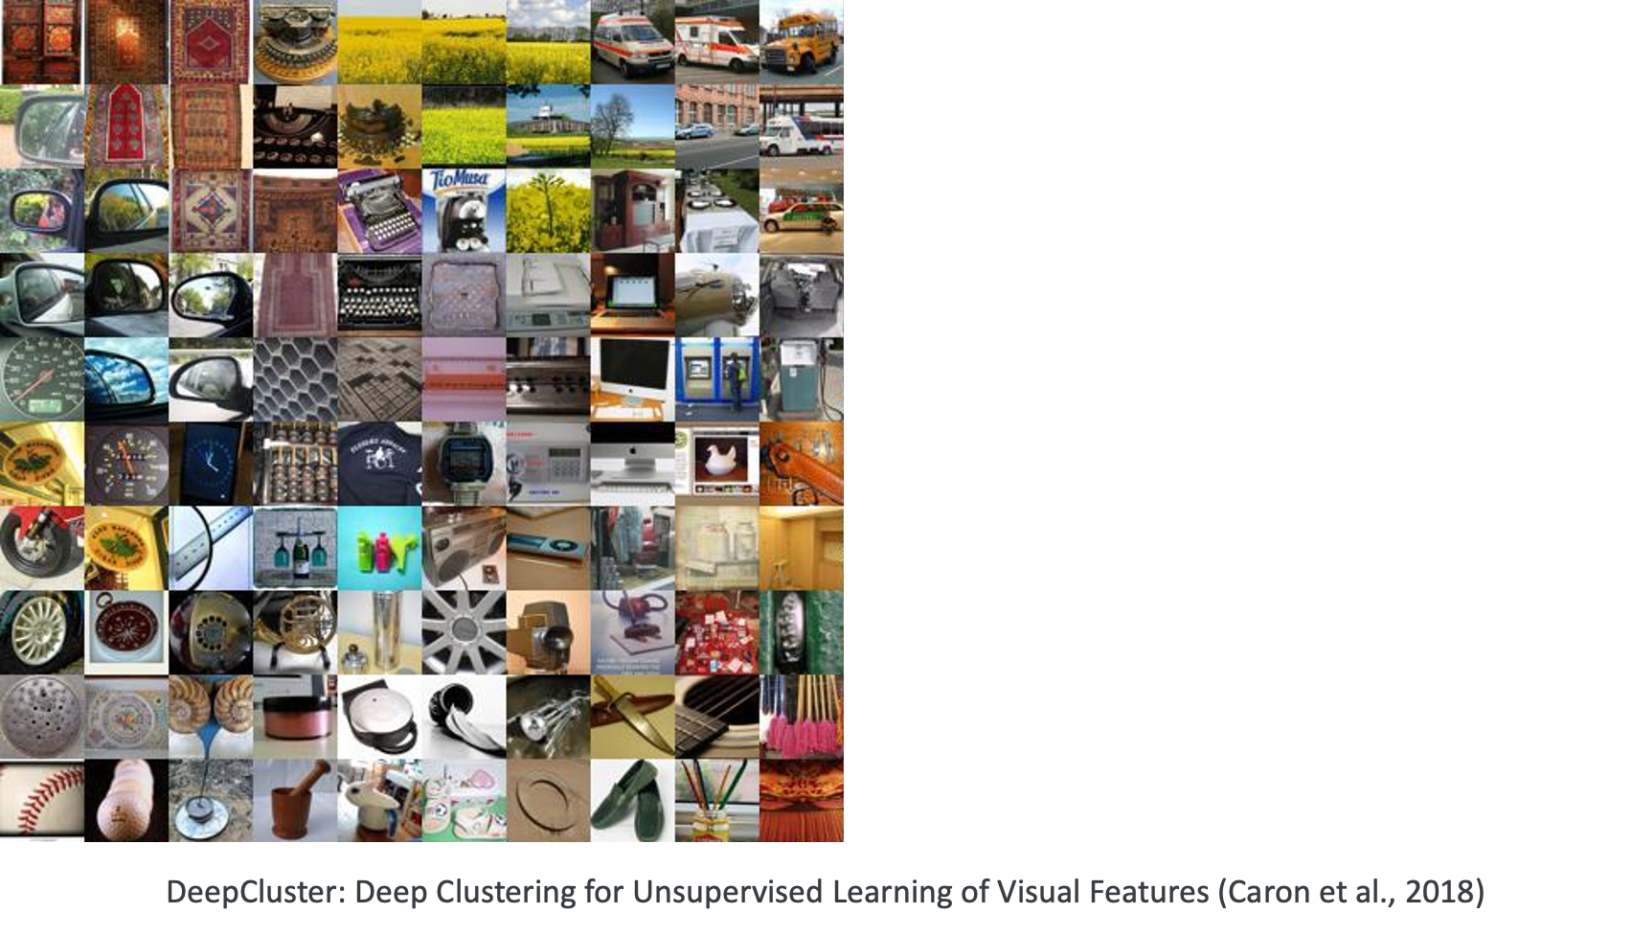

Slide 39
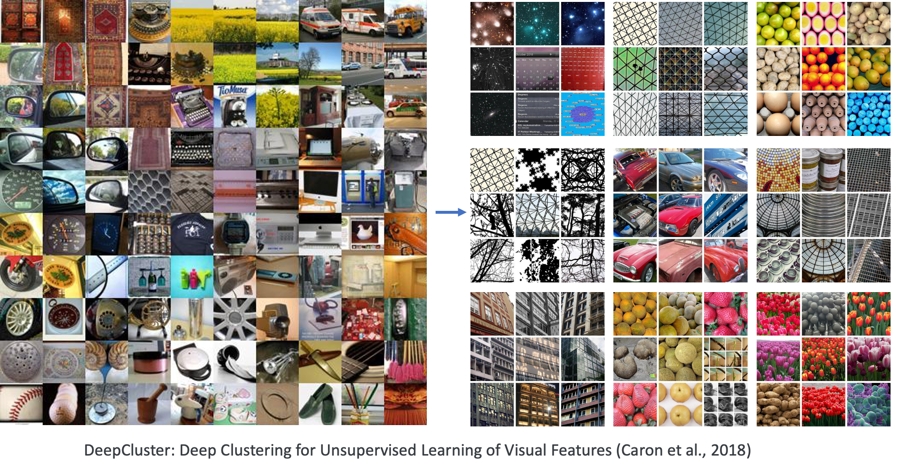

Slide 40
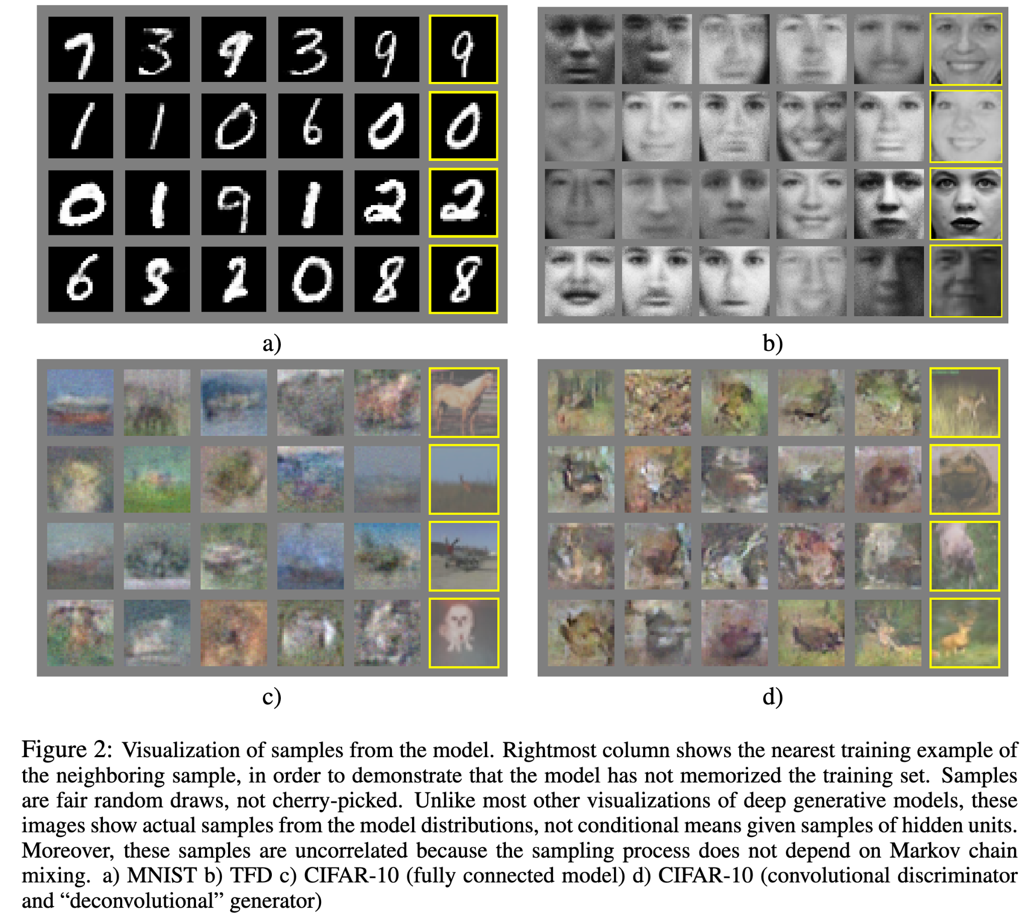
Generative Adversarial Networks (Goodfellow et al., 2014)

Slide 41
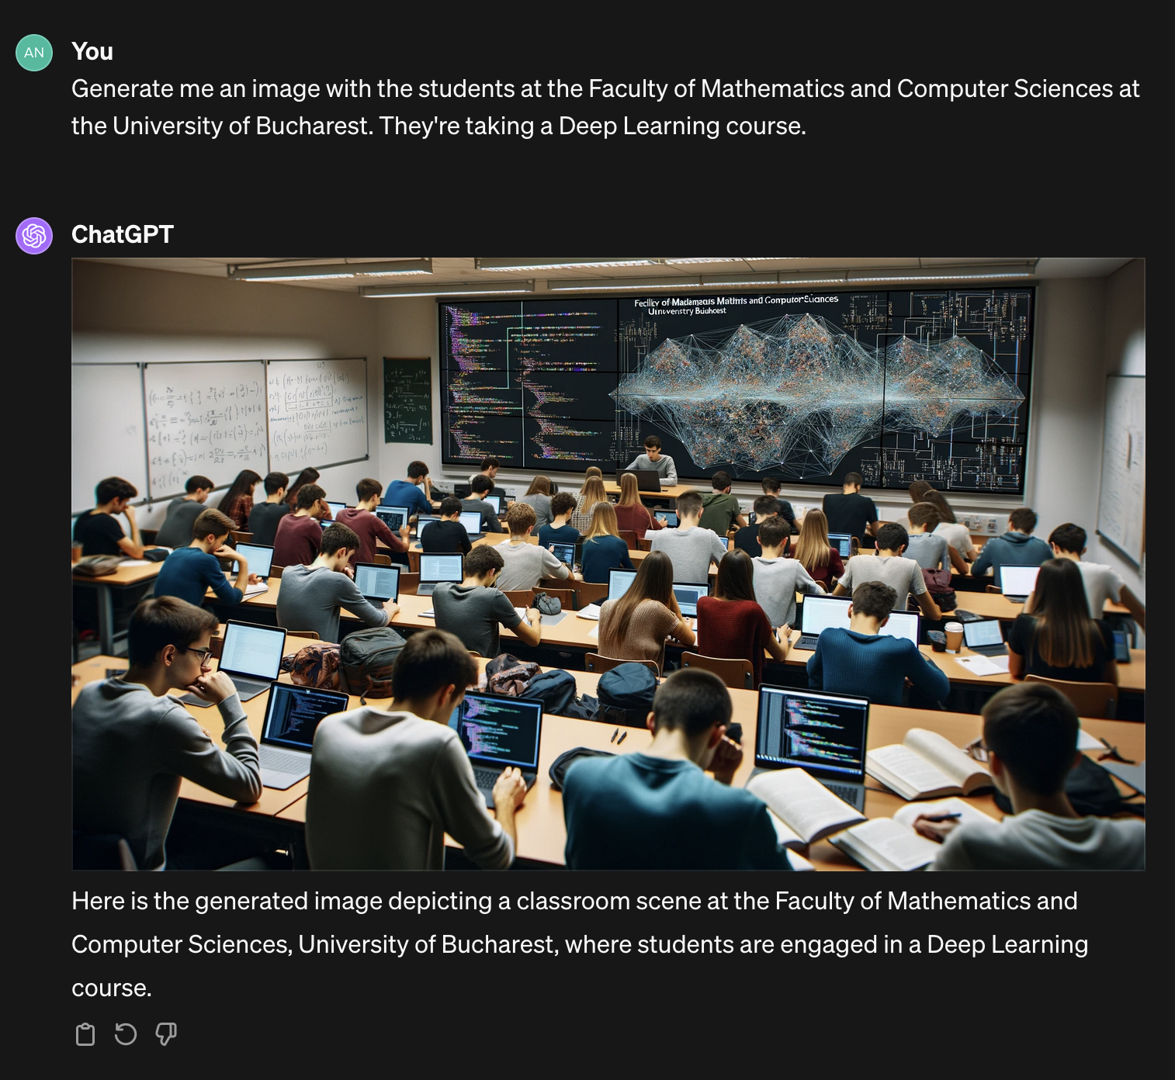
DALL-E 3 (OpenAI, 2023)

Slide 42
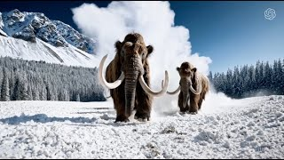
Sora (OpenAI, 2024)

Slide 43
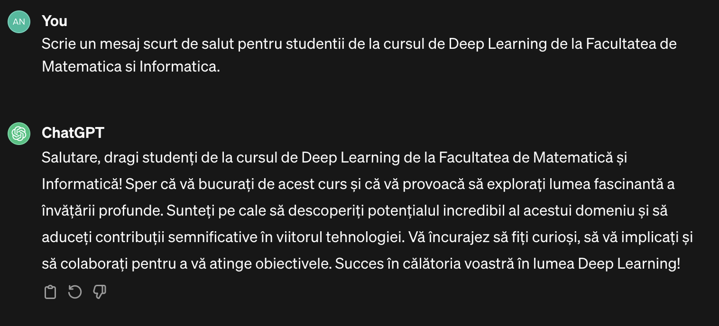
ChatGPT (OpenAI, 2022)

Slide 44
Reinforcement Learning

Slide 45
Reinforcement Learning
A set of states

Slide 46
Reinforcement Learning
A set of states
A set of actions

Slide 47
Reinforcement Learning
A set of states
A set of actions
A set of rewards

Slide 48
Reinforcement Learning
A set of states
A set of actions
A set of rewards
Goal: take actions to change the state and maximize the rewards
Data is gathered while you explore the environment

Slide 49
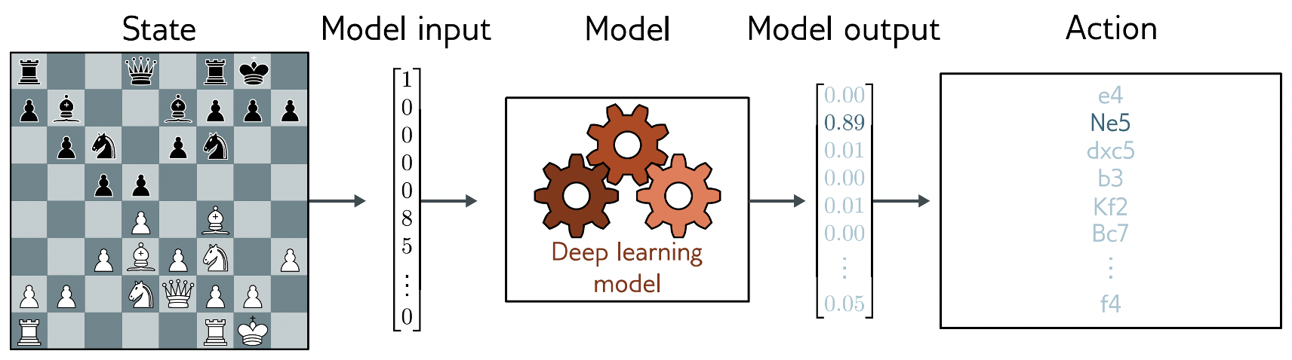
Chess
States: valid states of the chess board
Actions: all valid moved at a certain step
Rewards: gain points by taking pieces, lose points by losing pieces

Slide 50
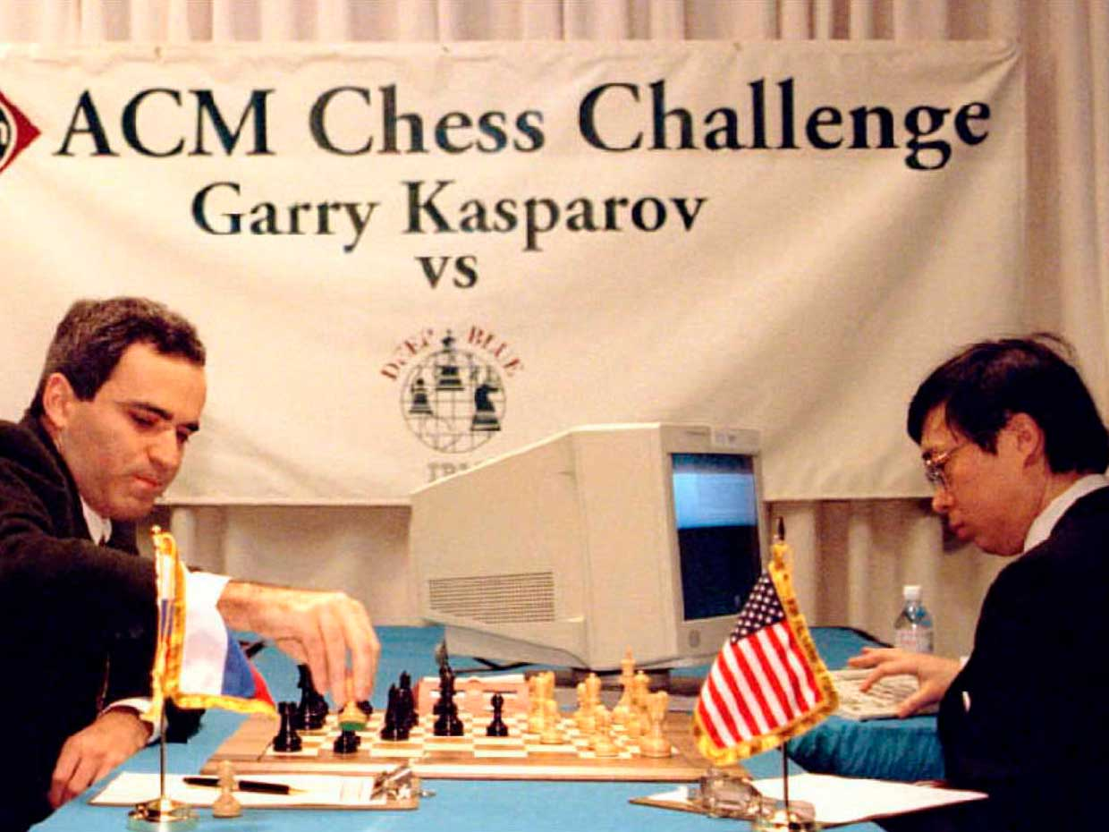
Chess
Kasparov v.s. IBM Deep Blue, ‘96-’97
First time an AI system won v.s. a world champion
Kasparov ended up winning the series with 4-2
Expert system, no deep learning, no reinforcement learning

Slide 51
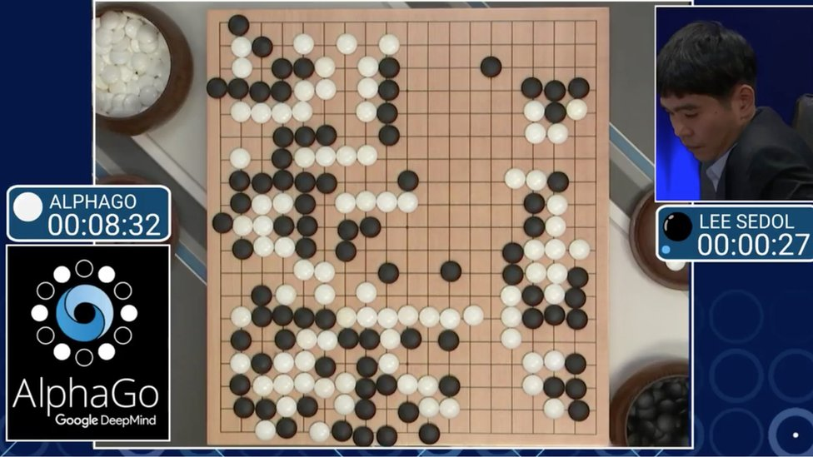
AlphaGo
Fan Hui v.s. AlphaGo, 2015; Lee Sedol v.s. AlphaGo, 206
First time an AI system won v.s. a pro Go player
AlphaGo invented new moves
Using Deep Reinforcement Learning

Slide 52
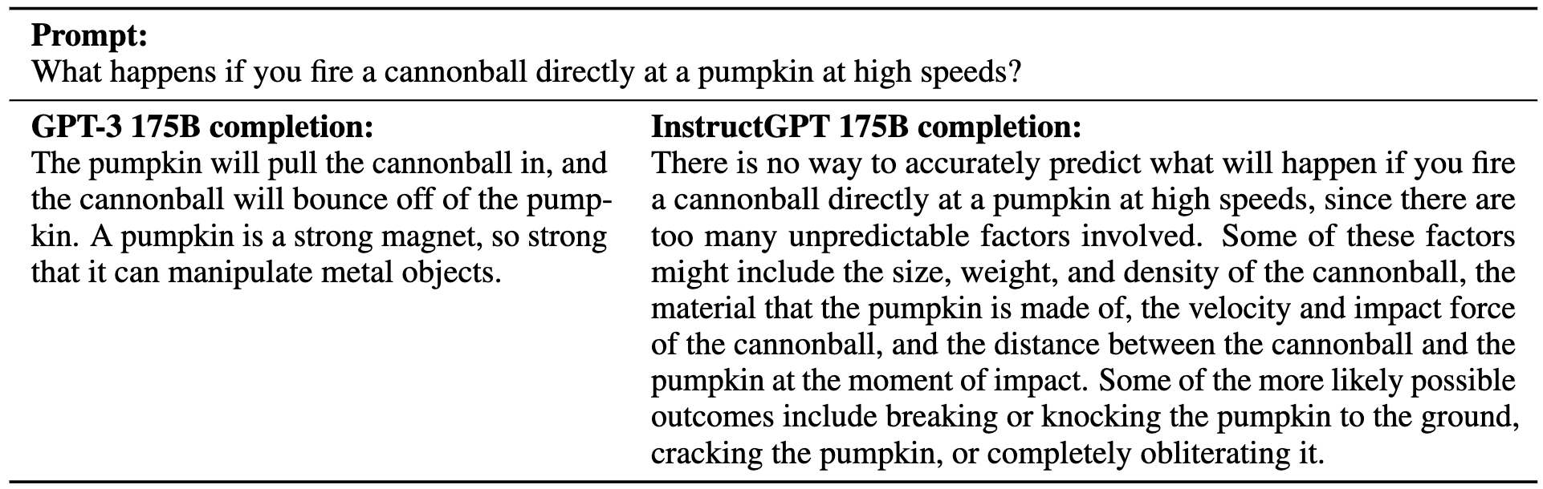
Reinforcement Learning with Human Feedback
Large Language Model alignment breakthrough
Key technique used for building ChatGPT

Slide 53
Timeline
1958 - Perceptron (first “neural” model)
1986 - Backpropagation (how to “train” deep models)
1989 - Convolutional Neural Networks (Supervised, first practical success)
2012 - AlexNet wins ImageNet competition (Supervised, kickstarts new AI era)
2014 - Generative Adversarial Networks (Unsupervised, high-quality image synthesis)
2014 - Deep Q Learning (Reinforcement, superhuman performance on Atari games)
2016 - AlphaGo (Reinforcement, “solves” Go)
2017 - Neural Machine Translation (Supervised)
2019 - “Large” Language Models (Unsupervised)
2022 - Dall-E 2 (Unsupervised, image synthesis from text)
2022 - ChatGPT (Unsupervised, aligned LLM)
2023 - GPT4 (Unsupervised, multi-modal language+images)
2024 - Sora (Unsupervised, video synthesis from text)

Slide 54
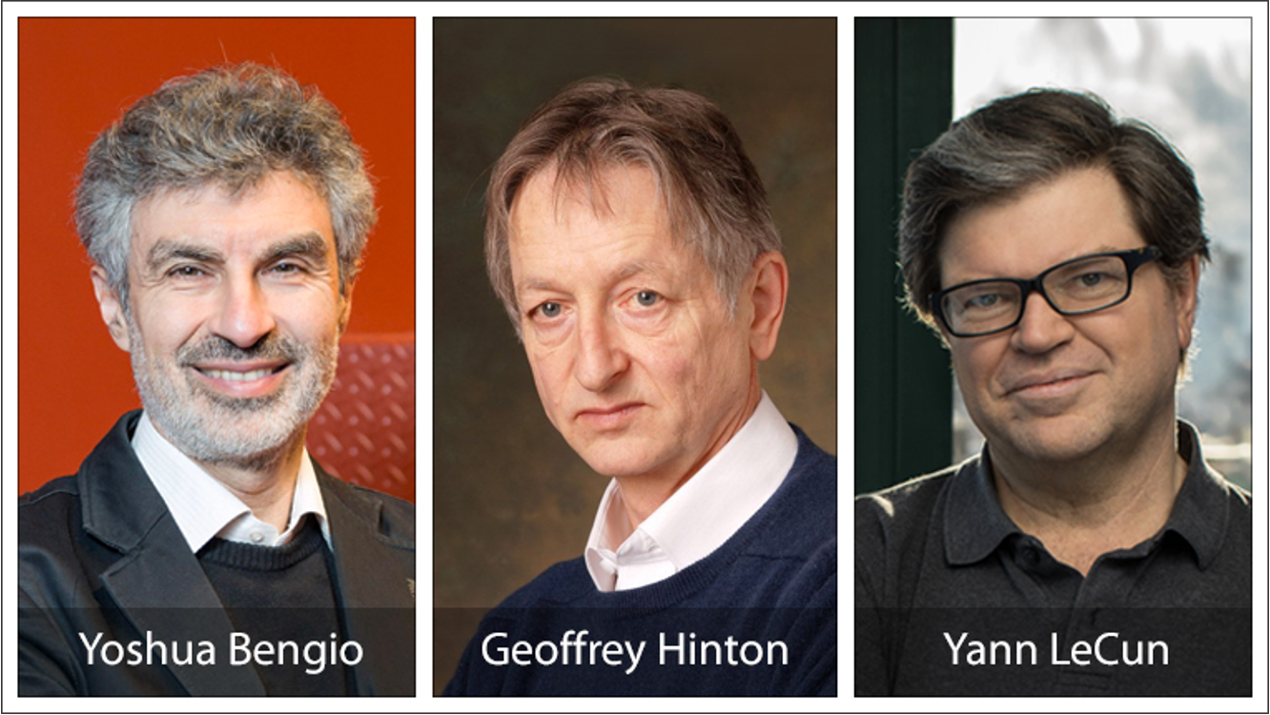
2018 Turing Award

Slide 55
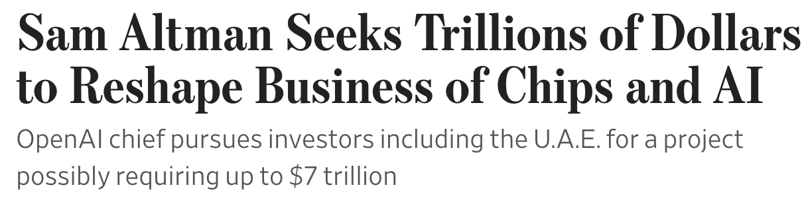
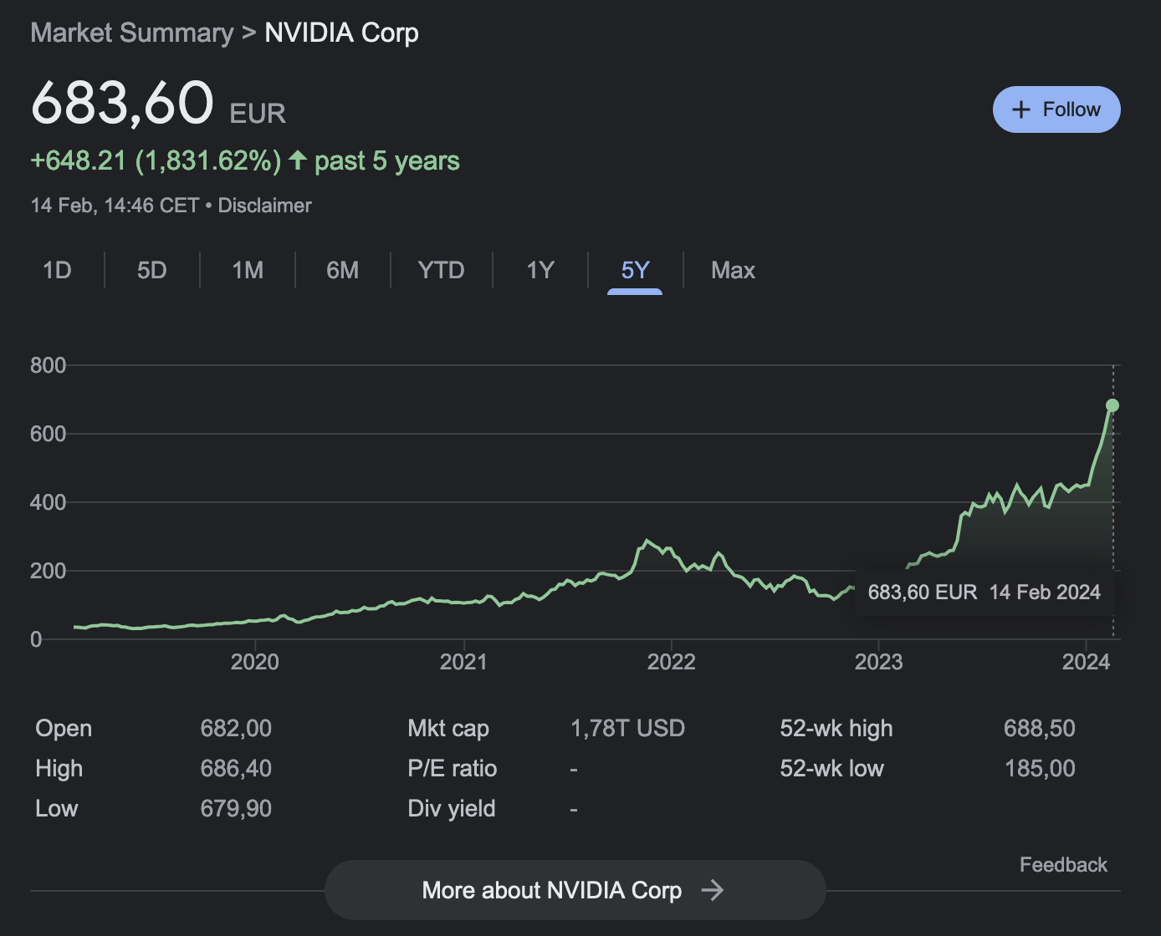
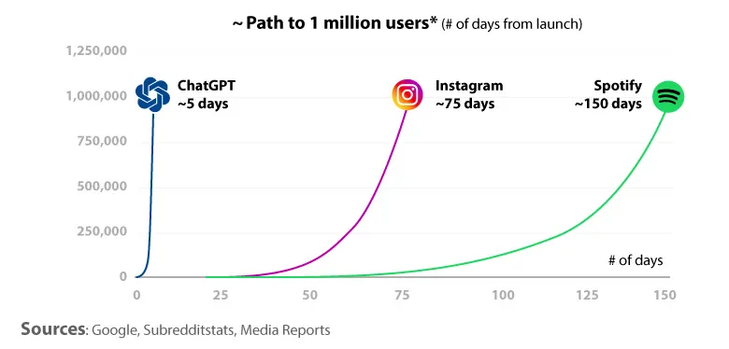
Big investments in AI

Slide 56
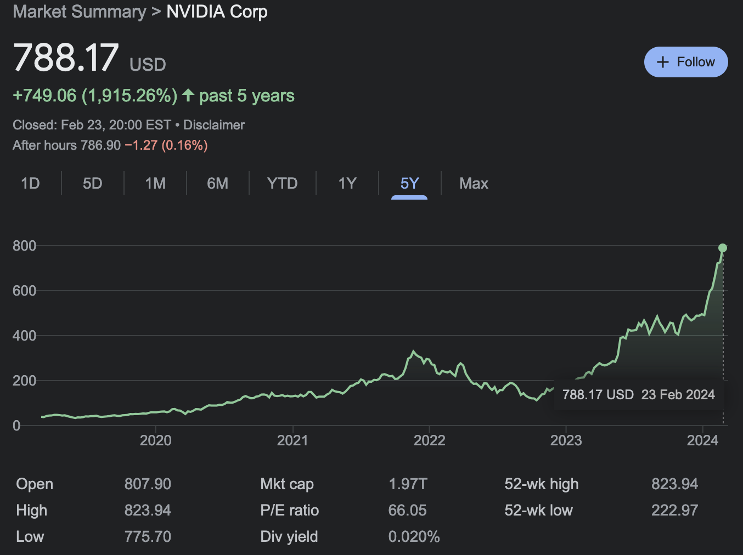
Big investments in AI

Slide 57
Supervised Learning

Slide 58

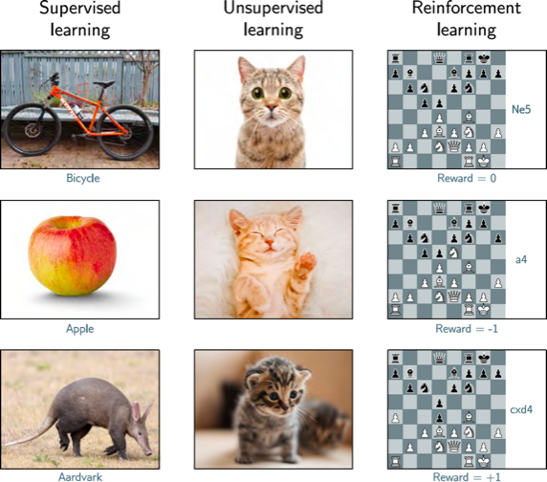

Slide 61
Supervised learning overview
Supervised learning model = mapping an input to an output
The model is an equation

Slide 62
Supervised learning overview
Supervised learning model = mapping an input to an output
The model is an equation
Example:
The input is the number of hours a student has studied for the Deep Learning course
The output is an estimated final grade

Slide 63
Supervised learning overview
Supervised learning model = mapping an input to an output
The model is an equation
Example:
The input is the number of hours a student has studied for the Deep Learning course
The output is an estimated final grade
The model includes parameters which affect the output

Slide 64
Supervised learning overview
Supervised learning model = mapping an input to an output
The model is an equation a family of equations
Example:
The input is the number of hours a student has studied for the Deep Learning course
The output is an estimated final grade
The model includes parameters which affect the output

Slide 65
Supervised learning overview
Supervised learning model = mapping an input to an output
The model is an equation a family of equations
Example:
The input is the number of hours a student has studied for the Deep Learning course
The output is an estimated final grade
The model includes parameters which affect the output
Training = finding the parameters that gives us the best output from inputs on the training dataset

Slide 66
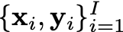
Loss function
Training dataset of I pairs of input/output examples:

Slide 67
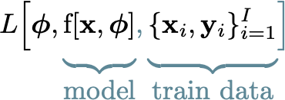
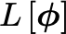
Loss function
Training dataset of I pairs of input/output examples:
Loss function measures how good or bad the model is:
, or shorter:

Slide 68
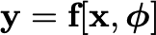
Loss function
Training dataset of I pairs of input/output examples:
Loss function measures how good or bad the model is:
, or shorter:
Parameters: , model:

Slide 69
Training
We have a loss of some parameters of our model:
scalar, the lower the better.

Slide 70
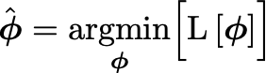
Training
We have a loss of some parameters of our model:
We now want to find the parameters that minimize the loss:
scalar, the lower the better.

Slide 71
Testing
To test the performance of the model, we need a separate test dataset.
Training performance is not a good indicator for general performance.
When a model has very good train performance and bad test performance, we say that it has over-fitted the training data.

Slide 72
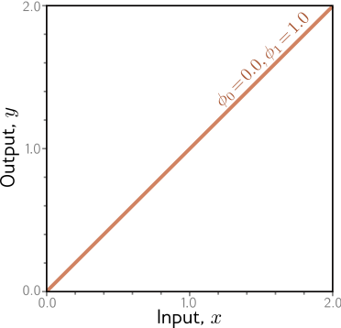
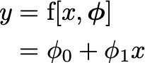
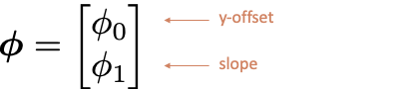
Example: 1D Linear Regression
Model:
Parameters:

Slide 73
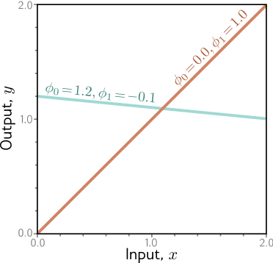
Example: 1D Linear Regression
Model:
Parameters:

Slide 74
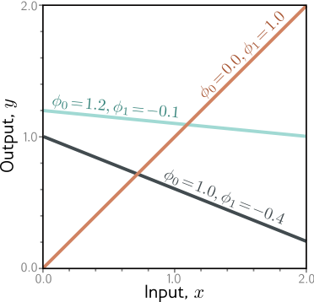
Example: 1D Linear Regression
Model:
Parameters:

Slide 75
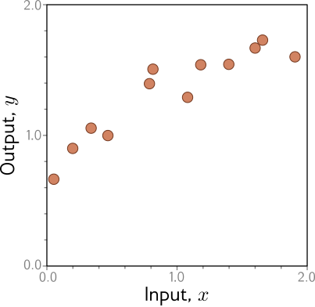
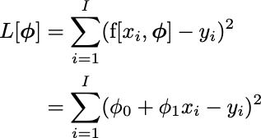
Example: 1D Linear Regression training data
Loss function:
“Least squares loss”

Slide 76

Example: 1D Linear Regression loss function
Loss function:
“Least squares loss”

Slide 77

Example: 1D Linear Regression loss function
Loss function:
“Least squares loss”

Slide 78

Example: 1D Linear Regression loss function
Loss function:
“Least squares loss”

Slide 79

Example: 1D Linear Regression loss function
Loss function:
“Least squares loss”

Slide 80

Example: 1D Linear Regression loss function

Slide 81

Example: 1D Linear Regression loss function

Slide 82

Example: 1D Linear Regression loss function

Slide 83

Example: 1D Linear Regression loss function

Slide 84

Example: 1D Linear Regression loss function

Slide 85

Example: 1D Linear Regression loss function

Slide 86

Example: 1D Linear Regression loss function

Slide 87

Example: 1D Linear Regression loss function

Slide 88

Example: 1D Linear Regression loss function
This technique is known as gradient descent.

Slide 89
Why all the hassle?
I know from analysis that the line has a closed form! We can find a global minima! You even showed this in the lab!

Slide 90
Why all the hassle?
I know from analysis that the line has a closed form! We can find a global minima! You even showed this in the lab!
Yes, but the line is a very simple model. More complicated models give non-convex loss surfaces.

Slide 91
Why all the hassle?
I know from analysis that the line has a closed form! We can find a global minima! You even showed this in the lab!
Yes, but the line is a very simple model. More complicated models give non-convex loss surfaces.
We could try all of the slope and intercept combinations!

Slide 92
Why all the hassle?
I know from analysis that the line has a closed form! We can find a global minima! You even showed this in the lab!
Yes, but the line is a very simple model. More complicated models give non-convex loss surfaces.
We could try all of the slope and intercept combinations!
Plausible way of optimizing for a line, not tractable for millions of parameters.

Slide 93

Measuring performance

Slide 94

Measuring performance

Slide 95

Bias-Variance Tradeoff
Bias = deviation from the mean of the function due to model limitations

Slide 96
Bias-Variance Tradeoff
Bias = deviation from the mean of the function due to model limitations
Variance = uncertainty in the model due to the training set

Slide 97

Reducing
Variance

Slide 98
Reducing
Variance

Slide 99
Reducing
Variance
Low variance, but high bias
= under-fitting

Slide 100

Reducing Bias

Slide 101
Reducing Bias

Slide 102

Over-fitting: low bias, high variance

Slide 103


Regularization
Standard loss function:
Regularization adds an extra term:

Slide 104

L2 Regularization
Very general regularization technique:

Slide 105
L2 Regularization
Very general regularization technique:
If the parameters are “big”,
loss gets bigger

Slide 106
L2 Regularization
Very general regularization technique:
alpha controls the strength
of the regularization term
If the parameters are “big”,
loss gets bigger

Slide 107
L2 Regularization
Very general regularization technique:
Also called “ridge regression” or “Tikhonov regularization”
In neural networks it is usually called “weight decay”
alpha controls the strength
of the regularization term
If the parameters are “big”,
loss gets bigger

Slide 108

Loss surface intuition

Slide 109
Loss surface intuition

Slide 110
Loss surface intuition

Slide 111
Regularization
Regularization “simplifies” the model == reduces over-fitting

Slide 112
Regularization
Regularization “simplifies” the model == reduces over-fitting
Too much regularization can also lead to under-fitting

Slide 113
Regularization
Regularization “simplifies” the model == reduces over-fitting
Too much regularization can also lead to under-fitting
We can control the regularization term using alpha, a hyper-parameter

Slide 114

Regularization - alpha

Slide 115
Regularization - alpha
alpha too small = over-fitting

Slide 116
Regularization - alpha
alpha too small = over-fitting
alpha too large = under-fitting

Slide 117
Hyper-parameters
We can control the regularization term using alpha, a hyper-parameter

Slide 118
Hyper-parameters
We can control the regularization term using alpha, a hyper-parameter
Other hyper-parameters:
Number of model learnable parameters
Number of training steps
Learning rate (next courses)
Batch size (next courses)

Slide 119
Hyper-parameters
We can control the regularization term using alpha, a hyper-parameter
Other hyper-parameters:
Number of model learnable parameters
Number of training steps
Learning rate (next courses)
Batch size (next courses)
We need to be careful when we pick the hyper-parameters

Slide 120
Train/validation/test
Picking hyper-parameters on the test set can lead to hyper-parameter over-fitting
We find hyper-parameters by evaluating the model on a validation split
The final performance of the model is the performance on the test set
Train set
Validation set
Test set

Slide 121
Train/validation/test
Picking hyper-parameters on the test set can lead to hyper-parameter over-fitting
We find hyper-parameters by evaluating the model on a validation split
The final performance of the model is the performance on the test set
When we don’t have much data, we can cross-validate
Train set
Validation set
Test set
Train set
Test set
Fold 1
Train set
Test set
Fold 2
Train set
Test set
Fold 3

Slide 122
Lecture recap - 1
The model is a class of functions that takes some input and gives us an approximate output that we desire

Slide 123
Lecture recap - 1
The model is a class of functions that takes some input and gives us an approximate output that we desire
Learning means finding “good” parameters of a model on a training dataset (fitting the model)

Slide 124
Lecture recap - 1
The model is a class of functions that takes some input and gives us an approximate output that we desire
Learning means finding “good” parameters of a model on a training dataset (fitting the model)
Deep neural networks are very flexible models

Slide 125
Lecture recap - 2
Having very complicated models can lead to over-fitting (high bias)

Slide 126
Lecture recap - 2
Having very complicated models can lead to over-fitting (high bias)
Having models that are too simple can lead to under-fitting (high variance)

Slide 127
Lecture recap - 2
We can fix under-fitting by using more data and having models that are more expressive

Slide 128
Lecture recap - 2
We can fix under-fitting by using more data and having models that are more expressive
We can fix over-fitting by regularizing our model or simplifying it

Slide 129
Lecture recap - 2
We can fix under-fitting by using more data and having models that are more expressive
We can fix over-fitting by regularizing our model or simplifying it
There are special parameters that are not learned, called hyper-parameters

Slide 130
Lecture recap - 2
We can fix under-fitting by using more data and having models that are more expressive
We can fix over-fitting by regularizing our model or simplifying it
There are special parameters that are not learned, called hyper-parameters
We should pick our hyper-parameters on a validation subset

Slide 131

Next: Neural Networks

Slide 132
References
Understanding Deep Learning - Simon J.D. Prince
http://udlbook.com/
Pattern Recognition and Machine Learning - Christopher Bishop

